Slide 1
Diving Into TidalScale
Scale It Out..…. Or Scale It Up?
Ike Nassi – CTO and Founder, TidalScale
TTI/Vanguard
2021-09-21

Slide 2
Key Takeaways
This is a disruptive technology. It changes our notion of what a ”server” is
A server can scale up or scale down based on what it’s doing, and soon, do it automatically
Instead of modifying application software and data to fit the server, the server now can be modified to fit the application and data
No changes to existing hardware, operating systems, applications or databases are required
The same mechanisms can dramatically improve server reliability

Slide 3
So, What’s New?
We’ve now defined the term “Software-Defined Server”
We have a new front end management console to control creating, configuring, monitoring, starting and stopping them
Big breakthrough on reliability:
  Last time I spoke at TTI/V I was asked at about reliability.
  I can now report that even in the presence of impending hardware failures, about 90% of the time, the operating system and all running applications continue to run while the hardware is being fixed or replaced.
  (I know, it sounds like magic.)
  I’ll describe how it’s done.

Slide 4
What is a TidalScale Software Defined Server?
It is a distributed virtual server
The virtual server runs across a cluster of closely cooperating, dedicated, off-the-shelf commodity servers, connected by Ethernet.
The virtual server combines all the processors, all the memory, all the disks, and all the local storage and treats this set of resources as the virtual machine
The virtual server boots a standard operating system (several are supported)
No changes to the hardware, OS or any applications are required
It runs as if it were a single very large server

Slide 5
Traditional View of Virtualization…
Multiple Virtual Machines sharing a single server
Virtual Machine
Virtual Machine
Virtual Machine
Virtual Machine
Virtual Machine
Virtual Machine
Physical Machine

Slide 6
TidalScale Software Defined Server
Single Virtual Machine sharing multiple servers
Virtual Machine
Physical Machine
Physical Machine
Physical Machine
Physical Machine
Physical Machine
Physical Machine

Slide 7
Advantages
Scale up or scale down as needed
No changes to apps or operating systems
Automatically and dynamically optimizes, based on machine learning and introspection
No special hardware
Minimal performance degradation
100X improvement in virtual server reliability

Slide 8
Rethinking DRAM from the SW Point of View
Where is the DRAM? Answer: It depends on your point of view:
From the host point of view (i.e. HW), the physical motherboard.
From the guest point of view (i.e. OS), it’s also on a motherboard, but that motherboard is virtual.
From the guest point of view, “physical” DRAM is actually a cache of host memory.
In other words, guest DRAM is a cache. It’s an all-cache design.
Guest
Application Software
Application Software
vCPU
Operating System
Operating System
vCPU
RAM
vCPU
RAM
vCPU
RAM
RAM
RAM
RAM
RAM
Virtual
Resources
RAM
CPU
CPU
RAM
CPU
RAM
RAM
CPU
RAM
RAM
RAM
RAM
HyperKernel
Physical
Resources
RAM
HyperKernel
HyperKernel
HyperKernel
Dedicated private interconnect
Host
Notes:
Under the covers, TidalScale uses machine learning to automatically co-locate compute entity with the resources it needs. And just like ordinary virtualization it does all of this transparently - the OS and applications have no idea they aren't running on hardware....

Slide 9
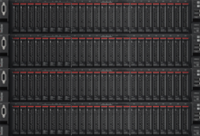
Under the Hood
One software-defined server
Application Software
vCPU
Operating System
vCPU
RAM
Software-Defined Servers
vCPU
RAM
vCPU
I/O
RAM
I/O
RAM
I/O
I/O
Multiple physical servers
CPU
CPU
RAM
CPU
RAM
I/O
Bare Metal Servers
CPU
RAM
I/O
RAM
I/O
Inverse-Hypervisor
I/O
Inverse-Hypervisor
Server 4
Inverse-Hypervisor
Server 3
Inverse-Hypervisor
Server 2
Server 1

Slide 10
Under The Hood
Memory page migration
Application Software
vCPU
Operating System
vCPU
RAM
vCPU
RAM
vCPU
I/O
Uses 2 levels of hardware based dynamic address translation
Migrates vCPUs and memory transparently to the guest OS
Dynamically and automatically load balances
Self-optimizing using ML
No central control
How?
RAM
I/O
RAM
I/O
I/O
CPU
CPU
RAM
CPU
RAM
I/O
CPU
RAM
I/O
RAM
I/O
Inverse-Hypervisor
I/O
Inverse-Hypervisor
Server 4
Inverse-Hypervisor
Server 3
Inverse-Hypervisor
Server 2
Server 1

Slide 11
Under The Hood
Virtual CPU migration
Application Software
vCPU
Operating System
vCPU
RAM
vCPU
RAM
vCPU
I/O
Uses 2 levels of hardware based dynamic address translation
Migrates vCPUs and memory transparently to the guest OS
Dynamically and automatically load balances
Self-optimizing using ML
No central control
How?
RAM
I/O
RAM
I/O
I/O
CPU
CPU
RAM
CPU
RAM
I/O
CPU
RAM
I/O
RAM
I/O
Inverse-Hypervisor
I/O
Inverse-Hypervisor
Server 4
Inverse-Hypervisor
Server 3
Inverse-Hypervisor
Server 2
Server 1

Slide 12
Scale Up or Scale Out?
 | Scale Up | Scale Out | TidalScale
Software Simplicity | ✔ | ✗ | ✔
Hardware Cost | ✗ | ✔ | ✔

Slide 13
Oracle 18c: Star Schema Benchmark, Scale Factor 1500
TidalScale Performance
Bare-Metal Server
Quad Socket, Intel V5
48 Cores 768GB
Queries / $
1X
TidalScale
2 x Dual Socket, Intel V4
24 Cores 1536GB
2.5X Faster
5X
TidalScale
2 x Dual Socket, Intel V4
24 Cores 1536GB
With Oracle “In-Memory”
20X Faster
30X

Slide 14
Reliability, Resiliency, and Compatibility
Hardware compatibility must be 100%. We run over 1500 server hardware acceptance tests. The OS thinks it’s running on hardware. The applications only know the OS on which they’re running.
Our SW reliability must be 100%.
We preserve processor semantics.
HW reliability is never 100%. But we can make it look 100% in the virtual machine.
We estimate about 90% of all hardware failures have an early-warning system of impending failure.

Slide 15
High Reliability: Self-Healing
Component | Typical Initial Failure | Time to Act | Next Failure | Relative Likelihood | TidalGuard™
DRAM | Correctable Errors | YES | Uncorrectable Error. Catastrophic | Highest | YES
Power Supply & Fans | Loss of initial device results in single point of Failure | YES | Catastrophic | High | YES
Networking | Loss of connection results in single point of Failure | YES | Catastrophic | High | YES
Storage | Loss of Connection or Drive | YES | Catastrophic | High | YES
Everything else | Varies | Maybe | Catastrophic | Much Lower | Maybe
90%
Self-Heal 90% of problems BEFORE FAILURE. Zero Downtime

Slide 16
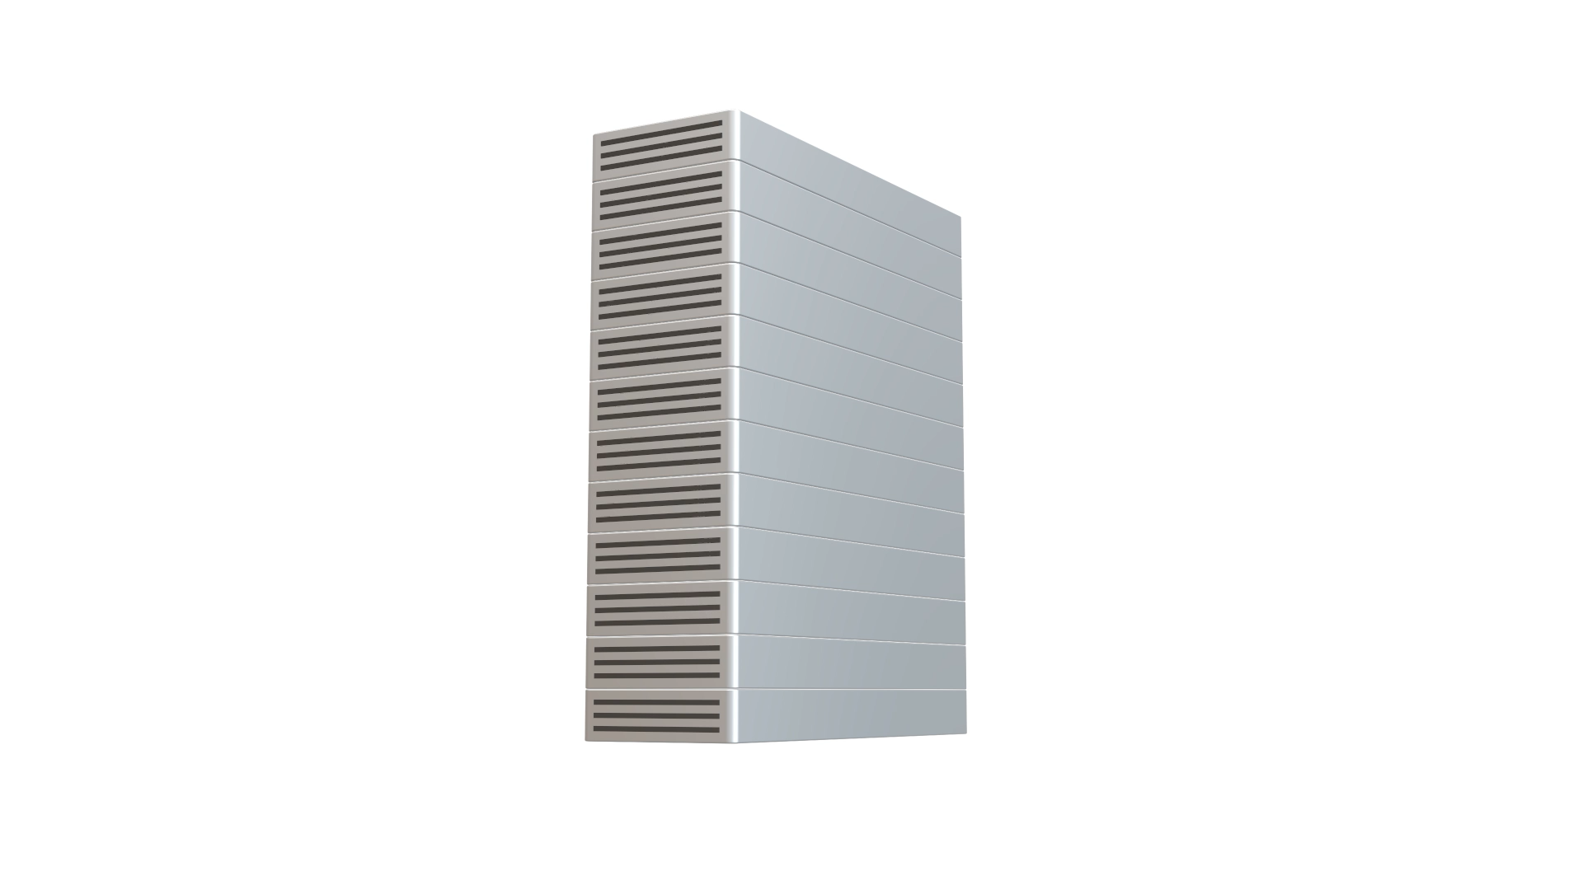

Slide 17
Advantages of TidalGuard™
Coherency across all nodes is always maintained
Resources are pulled and pushed to ”best” location.
Push
  Virtualized vCPUs are moved to the new & existing nodes
Pull
  vCPUs pull active pages (working sets) to location needed
  Delta changes on failing node fall to zero
Push
  Remaining “stale” pages are pushed to spare nodes
  Replicated read-only pages are dropped

Slide 18
The WaveRunner Management Console

Slide 19
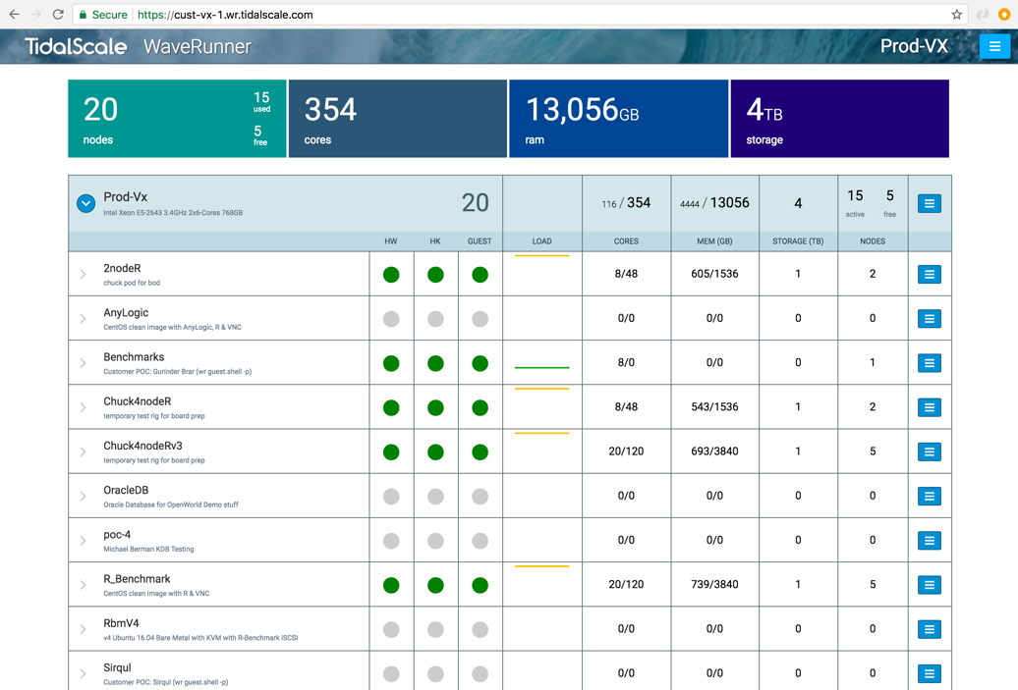
WaveRunner: Deploy in Minutes
Available Nodes
Click to Start
SAP HANA
In-Memory Database
TIBCO Spotfire
R Analytics
Oracle DB
In-Memory Database
Amazon Web Services
IaaS Bare Metal Instance
Spark ML
Scale-out Analytics
Oracle Cloud Infrastructure
IaaS Configuration
Sirqul
Real-Time IoT
Docker
SDS Container Deployment
Lenovo
SR650 Validation System
Microsoft Windows
Windows Alpha System

Slide 20

WaveRunner: Deploy in Minutes
SAP HANA
In-Memory Database
TIBCO Spotfire
R Analytics
Oracle DB
In-Memory Database
Amazon Web Services
IaaS Bare Metal Instance
Spark ML
Scale-out Analytics
Deployed Server
My First TidalScale System
Demo System
Sirqul
Real-Time IoT
Docker
SDS Container Deployment
Lenovo
SR650 Validation System
Microsoft Windows
Windows Alpha System

Slide 21





Self-Optimizing
Networking
& Storage
Standard
Computing
Self-Healing
Self-Sizing
Future

Slide 22
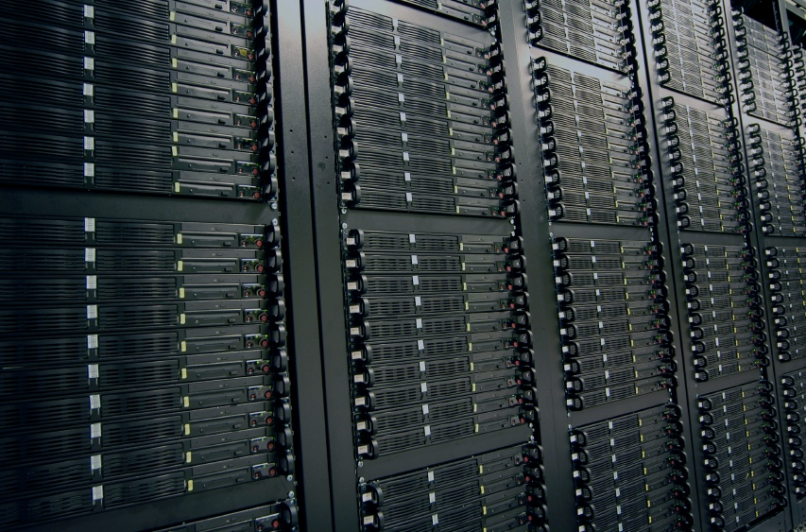
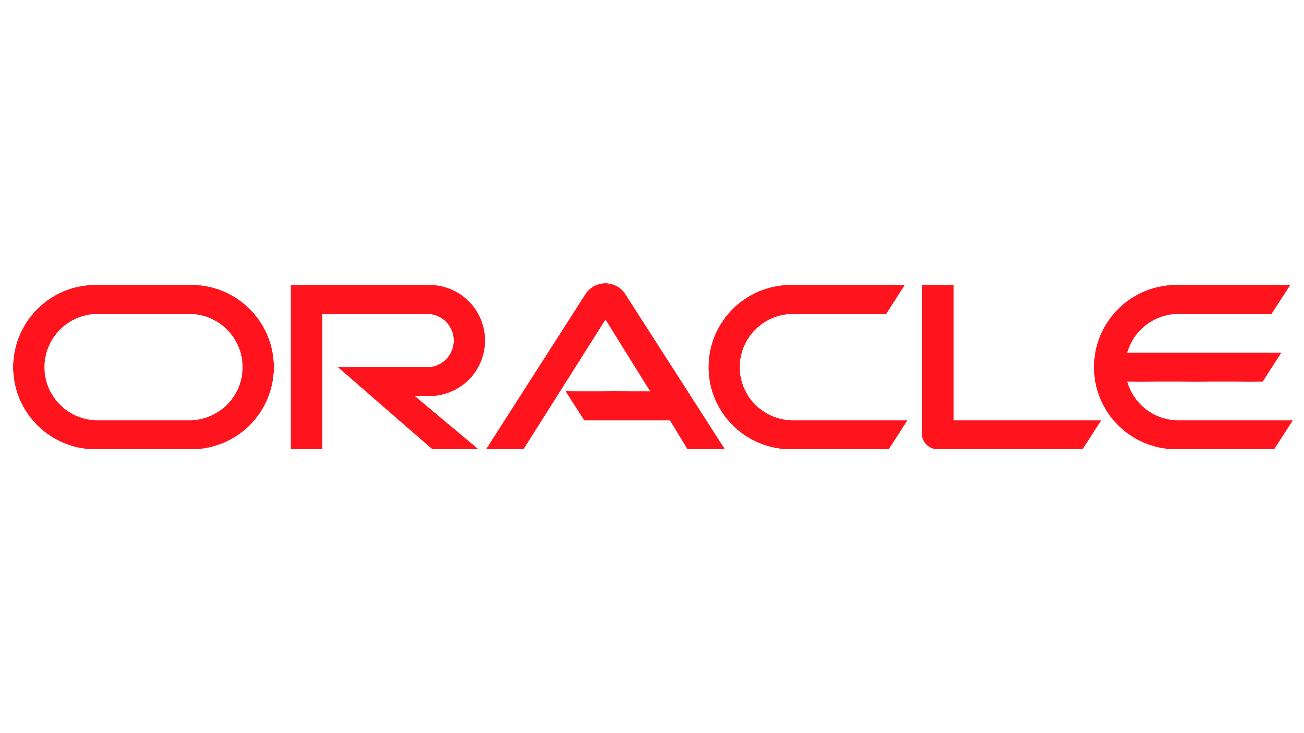

Faster. Lower-Cost. Software-Defined.
Faster Deployment
Lower Cost
Analytics
Create and resize within minutes
Avoid wasting months on sizing and deploying specialty systems
Building block = commodity hardware
Avoid purchasing specialty systems
Minimize core-based licensing costs
25x faster
50% – 75%
cost savings
Performance
Witness “in-memory” performance
All active data in memory
up to 2.5x faster
Reliability & Uptime
Add two “9’s” to your uptime
100X MTTR improvement
Self-healing systems
Agility
100x higher
Build-as-you-grow
Scale up or down easily
Unparalleled

Slide 23
Summary
Why it’s important to rethink some fundamental assumptions (counter-factual thinking)
How it works
OS Compatibility
Application Compatibility
Cost and Performance
Reliability
How to manage the landscape
Increase deployment options
30

Slide 24
“This is the way all servers will be built in the future”
- Gordon Bell
Programming an Application When Memory Size Is No Longer A Constraint, IEEE Computer, August 2017
Revisiting Scalable Coherent Shared Memory, Bell and Nassi, IEEE Computer, Special Issue: Outlook 2018, January 2018

